Slide 1


ProChange Inc
Kai-Hong You
Nimisha Reddy Kolukuri
Ramanathan Venkatakrishnan

Slide 2


Problem Statement
Climate change has been a growing concern for not just Americans, but people around the world.
Despite widespread endorsement that Climate Change is a real and critical problem in our world, recent survey data indicates that 40% of adults have not yet made any significant changes to their behavior to combat climate change
Despite this statistic, the survey still indicates that almost 75% of adults are somewhat motivated about changing their behaviors to combat climate change
We developed Predictive Machine Learning Algorithms that analyzes tweets from Twitter. We did this by analyzing and segmenting the tweets into six distinct categories. We believe using the results from our model we can spread targeted educational material to climate change skeptics.

Slide 3

Project Objectives
Develop a Machine Learning Algorithm that analyzes tweets from Twitter.
Gain insights and strategies for combatting climate change.
Help convert non-believers of climate change to believers
We wanted to contribute to the global effort, for mitigate the effects of climate change by increasing public awareness and engagement.
By Analyzing what people are saying and feeling about climate change, we can provide individuals with targeted education and marketing to help them change from Climate Change Skeptics to Believers

Slide 4

Data Flow
Twitter Scrapping
Data Preprocessing
Sentiment Analysis
Power BI
Development
Analysis Interpretation
Data Analysis
Segmentation
Business
Insight

Slide 5
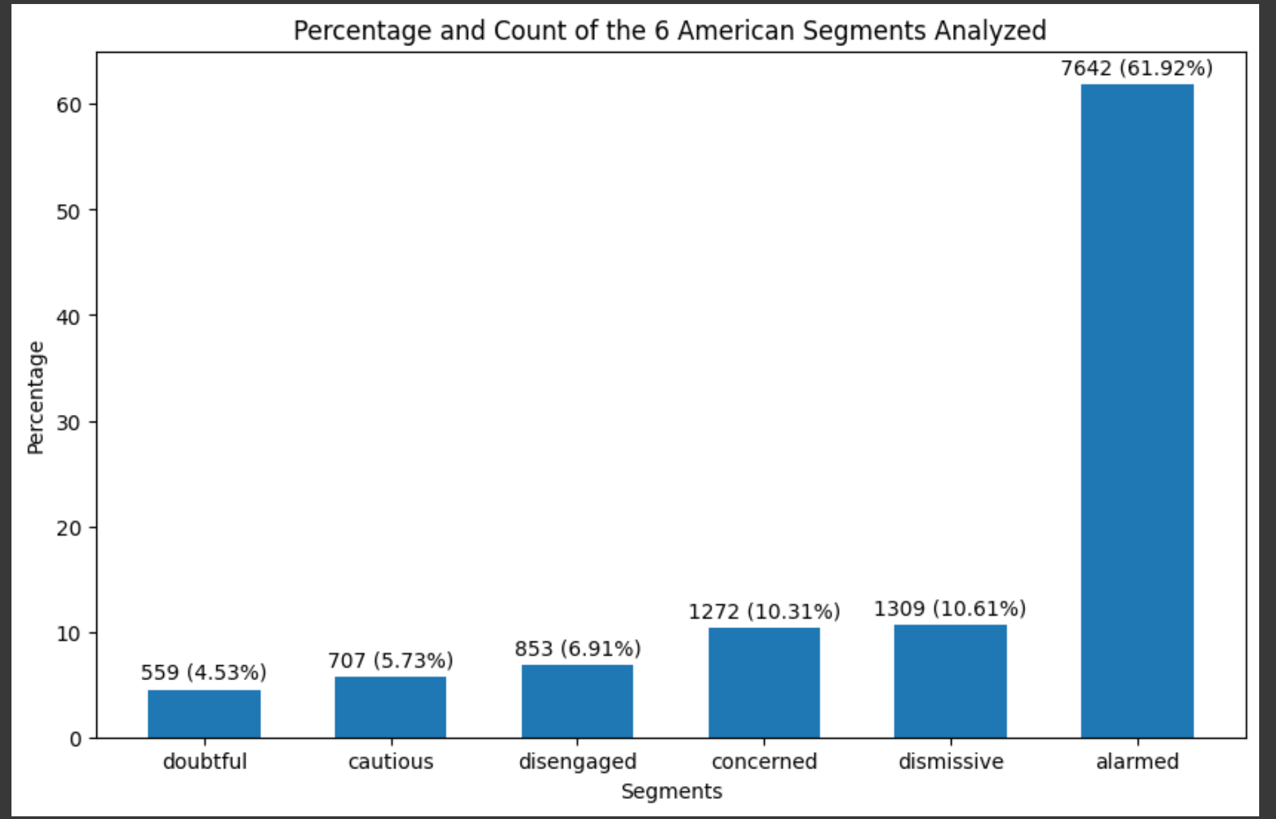
Breakdown of the Segments analyzed
We analyzed over 10,000 tweets with various keywords to get an even distribution of tweets from believers and non-believers of climate change, and broke down their sentiments into six distinct categories
Initial labeling was done through extensive keyword analysis.
Later we were able to automate the labeling process using ChatGPT to read the dataset and help label the tweets.

Slide 6
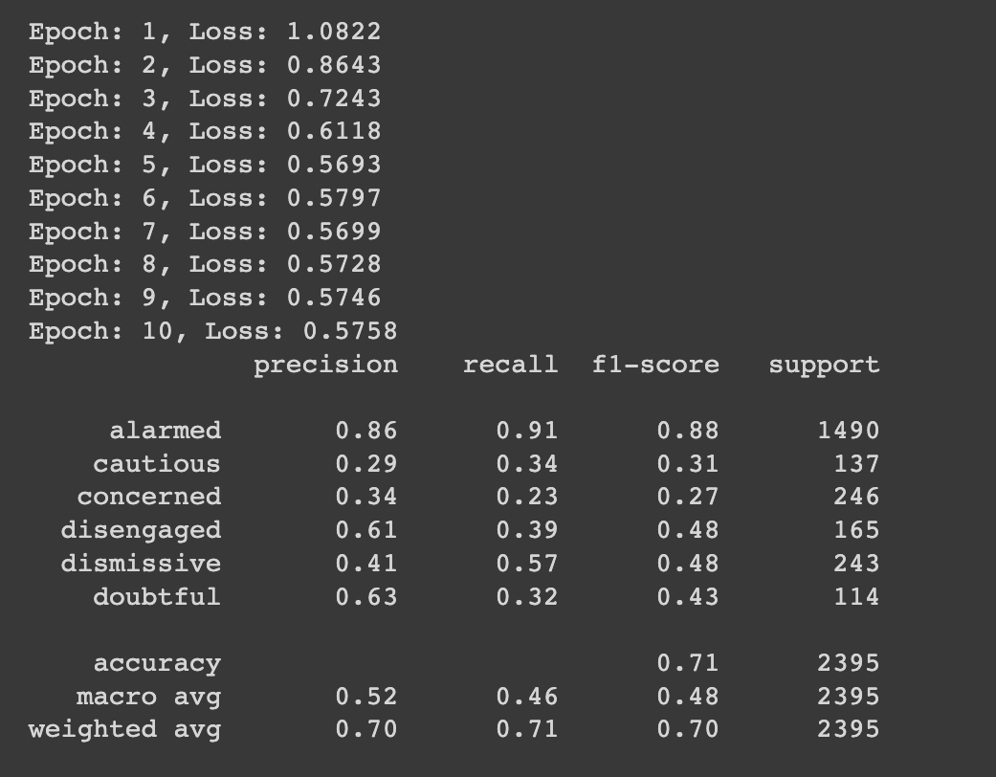
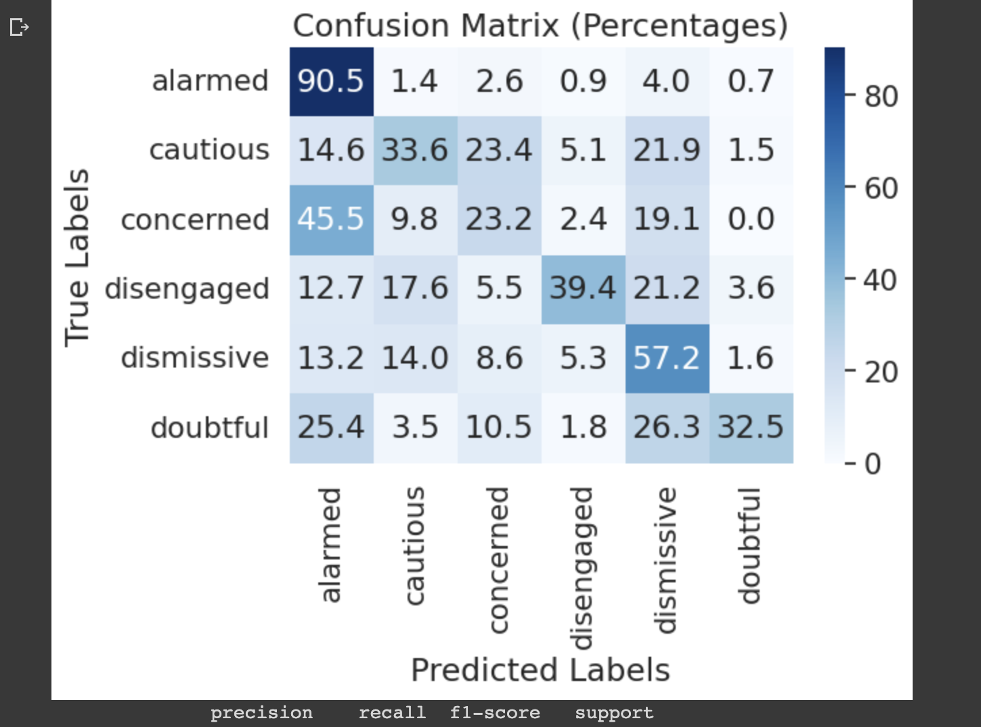
Bert Model Classification and Analysis
Our Bert model was able to classify into six segments with an accuracy of 71.40 % on
Test set.

Slide 7
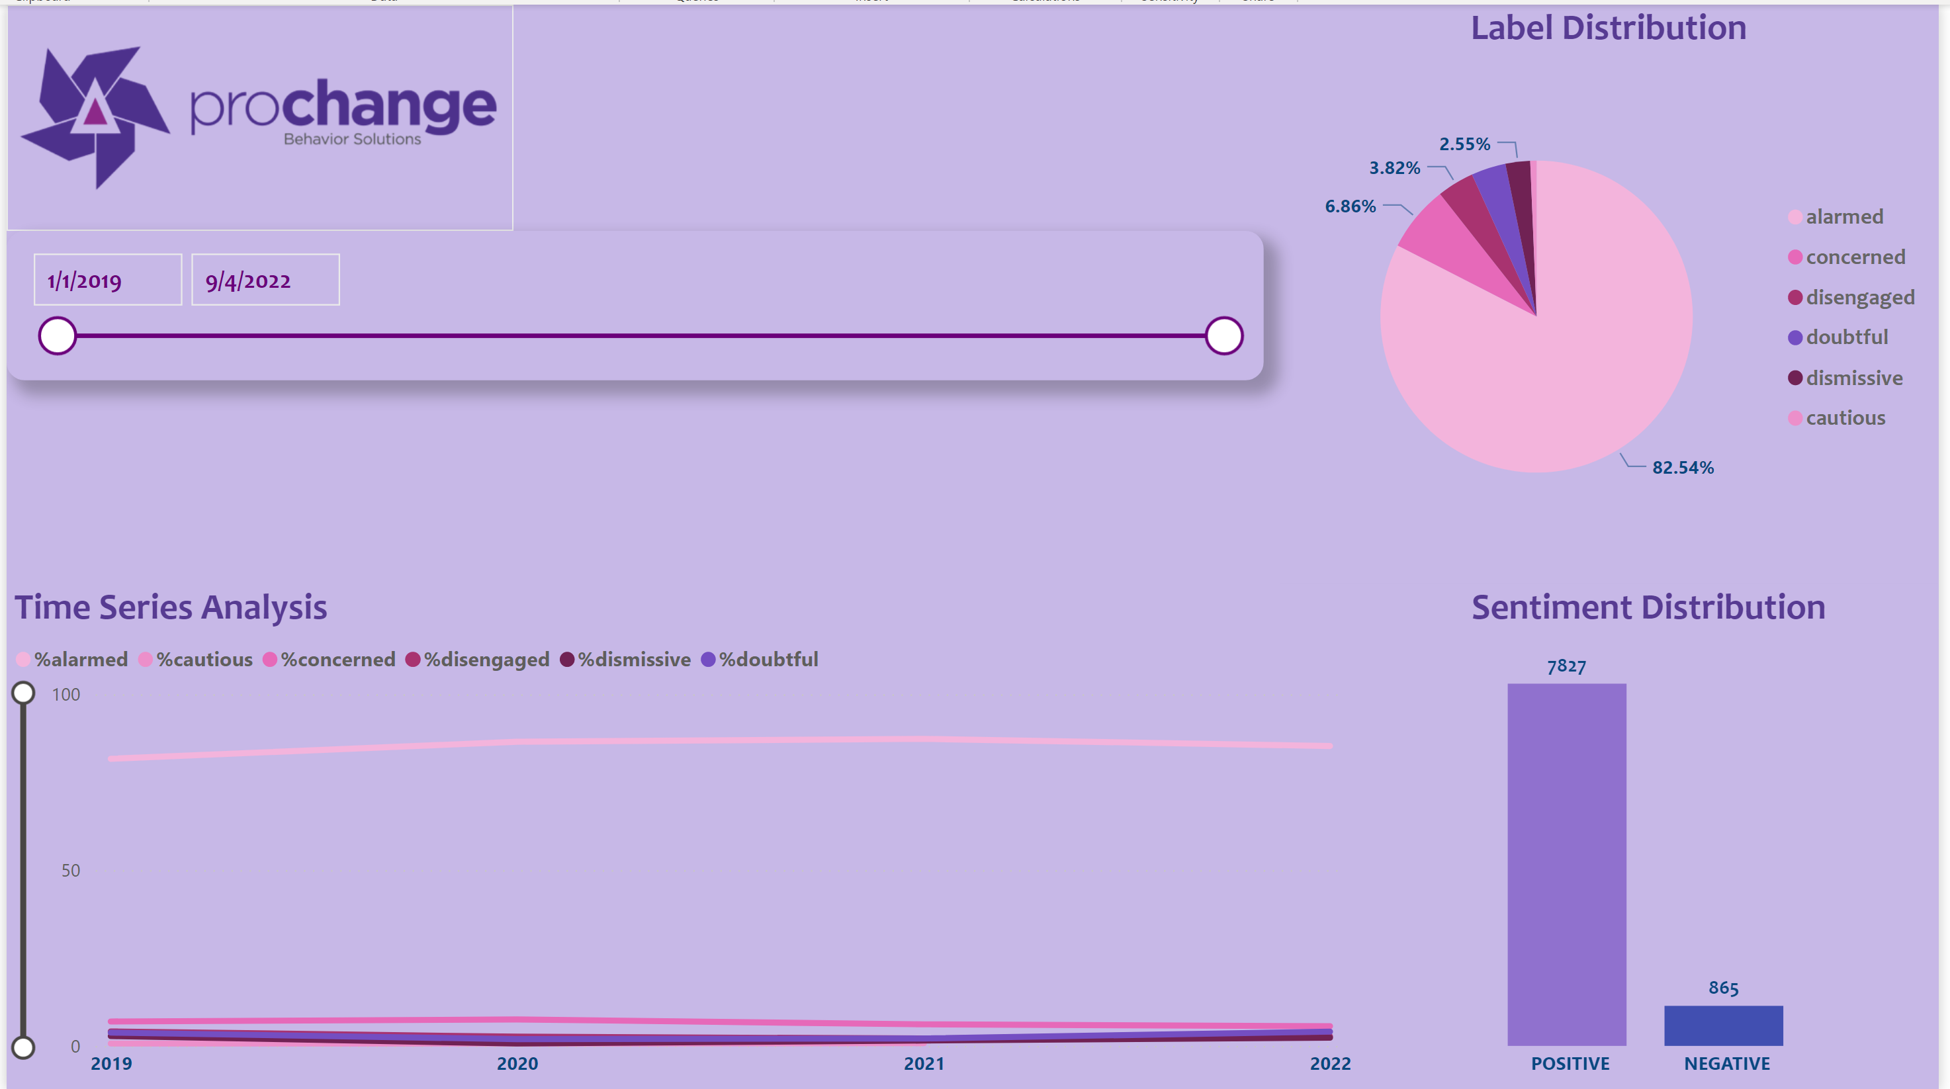
Dashboard
In the following Dashboard we created, we mapped out how people were feeling about climate change over time (2019-2022)
The dashboard provides a live update on the distribution of how people are feeling about climate change.. Over 82% of individuals analyzed were classified as “Alarmed” about climate change.
Moreover, we found that there is an overwhelmingly positive sentiment distribution, which implies that much more people are believers in climate change, and the tide against the skeptics of climate change, is turning.

Slide 8




Business Insights and Recommendations
Create campaigns to raise awareness about climate change
Partner with other organizations to reach wider audience and amplify their messages
Engage with local communities to educate people about the impacts of climate change. Provide targeted educational material to individuals that are Doubtful, Disengaged, and Dismissive about climate change

